Slide 1

Unmanned Maritime
Autonomy Architecture
Distribution Statement A
DISTRIBUTION A. Approved for public release: distribution unlimited
Distribution Statement A

Slide 2
What is UMAA?
A PMS 406 initiative to standardize interfaces to enable interoperability of system software for all USV and UUV programs
UMAA’s goal is to “realize” a shared services approach:
Enable software reuse across programs and platforms
Provide government-owned interface definitions to enable software interoperability
Enable the development of best-of-breed software components with standard interfaces
Enable industry contribution at a software component level versus only at a system level
UMAA defines interfaces for common autonomy services for unmanned surface and undersea vehicles
UMAA enables the development of “software services” akin to software “libraries”
UMAA enables the reuse of software services across programs that are developed as UMAA compliant
UMAA specifies protocols leveraging the “Data Distribution Services” (DDS) Standard and expanding to enable interoperability
UMAA is NOT “plug and play” - system engineering beyond the scope of UMAA is required for full interoperability of UMAA services
UMAA does NOT implement or provide software (except for examples, i.e., reference implementations)

Slide 3
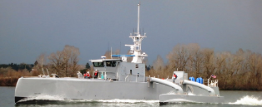



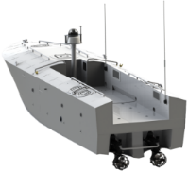
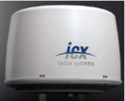



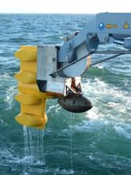


Systems of Today
(pick one of each)
Vehicles
External C2
Payloads
Unique
Vehicle
I/Fs
Unique C2 Interfaces
Unique
Payload
I/Fs
MOCU
TOPSIDE
CCS
Other
Veh_{1..n} x Payld_{1..m} x C2_{1…r}
Motivation behind UMAA
Mission
Autonomy
Vehicle Interfaces
Payload Interfaces
C2 Interfaces
Currently develop a specific solution for each:
vehicle – mission – payload – C2 combination

Slide 4
Interface Standards Approach
Vehicles
External C2
Payloads
Common C2
Interface Standards
Reduce scope
Reduce cost
Mission
Autonomy
Motivation behind UMAA
Interface Standards
Mission
Autonomy
Interface Standards
Map/Chart Services
Communication Services
Navigation Services
Data Fusion Services
Other Services….
Standard Services and Interfaces
Payloads - Varies by type so exploit commonality by type
Vehicles – interface content vastly common across vehicles
Make Systems Comply to a Standard

Slide 5
Shared Services Approach
Green shows notional services available on a shared DDS bus
Vehicle and Payload Systems
Mission Management
Communication Operations
Mission Control
Waterspace Plan
Mission Plan
Mission Status
Comms Control
Comms Status
Maneuver Operations
Situational Awareness
Waypoint Status
DDS Bus
Ownship Position
Waypoint Control
Ownship Velocity
Vector Status
Ownship Acceleration
Vector Control
Hover Status
Time
Hover Control
Compartment Status
Motivation behind UMAA
Drift Status
Drift Control
Contact
Racetrack Status
Racetrack Control
Mission Autonomy
CTD
Stationkeep Status
Mission Autonomy
Sea State
Stationkeep Control
Waterspace
Mission Autonomy
Engineering Operations
Engine Status
Sensor/Effector Management
Engine Control
Autonomy
Engine 1
GPS Status
Propulsor Status
Propulsor Control
Autonomy
Engine 2
INS Status
Rudder Status
Rudder Control
Autonomy
Engine 3
Camera Specifications
Thruster Status
Camera Configuration
Thruster Control
Digital Video Specifications
Fuel Status
Digital Video Configuration
Battery Status
H264 Specifications
Bell/Whistle/Gong Status
H264 Configuration
Bell/Whistle/Gong Control
Light Status
Still Image
Light Control
DDS Bus
PTU Status
Anchor Status
Anchor Control
PTU Control

Slide 6
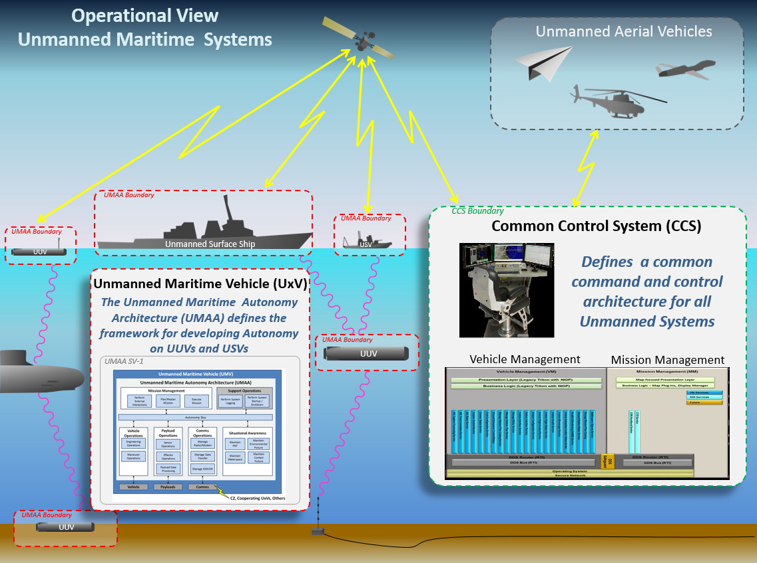
UMAA Scope
Standardizing common control and standardizing autonomy services provides an extensible solution for operators and developers to engage with increasing autonomy capabilities
Common Control System (CCS) is a separate initiative from UMAA to establish the operator control system
UMAA scope is confined to the onboard capabilities in a vehicle including the ability to collaborate autonomously with other vehicles

Slide 7
UMAA Organization
Program Manager*
CAPT Searles
CDR Delwiche
- Direction
- Membership
- Approval of deliverables
- Cross program coordination
Unmanned Maritime Autonomy Architecture
(UMAA) Interface Control
Working Group (ICWG)
(Direction, coordination)
Unmanned Maritime Autonomy Architecture Board (UMAAB*)
Chair*
Members*
- Program office coordination
- Architecture definition and evolution
- Governance
- Compliance standard
- Configuration control (IDL, ICDs, Reference Implementation
- Weekly teleconferences
- Industry days (live and virtual)
(Recommended updates)
(Update requests)
(Direction, coordination)
PM Liaison
Representative for Platform*
Liaison with UMAAB
Advocate for program requirements
Specification
Working Group (SWG)
- Members*
SME Consultants*
Reference Implementation Working Group (RWG)
- Implementation Lead(s)*
(ICDs, IDL,
Compliance)
- Model updates
- ICD content
- ICD/IDL tool chain
- Weekly teleconferences
- Reference Implementation
- Portability testing
- Compliance testing
- Bi-weekly teleconferences
(Program requirements)
(ICDs, IDL, Compliance)
Industry
- Interface input / feedback
- UMAA implementations
Program Development
(LDUUV, XLUUV, Razorback, MUSV, LUSV,…)
* Formal names from UMAAB charter

Slide 8


Unmanned System Standards
Joint Architecture for Unmanned Ground Systems (JAUGS)
  OSD charter established JAUGS WG 1997
  OSD updated charter established JAUS WG 2002
  JAUS governance transitioned to SAE AS-4 Committee 2004
  Original stakeholders – Ground robotics
UAS (Unmanned Aircraft Systems) Control Segment (UCS) Architecture
  OSD charter established UCS WG 2009
  UCS governance transitioned to SAE AS-4 Committee 2015
  SAE charter updated UxS Control Segment (UCS) 2015
  Stakeholders
    Common Control System (CCS)
UCSMDE (Multi-Domain Extension)
  OSD promoted UCS for the maritime domain 2013
  Evolved over the next few years by Community of Interest (COI)
The Object Management Group (OMG) Data-Distribution Service for Real-Time Systems (DDS) used is an open international middleware standard using publish-subscribe communications for real-time and embedded systems.

Slide 9
Alignment of UMAA and CCS
UCS
(Version 3.4)
Platform
Independent
Model (PIM)
MDE
(JSON)
UxSDK
Tool
SAE AS-4UCS
UCSMDE
CCS
UMAA
UMAA
(FreeMarker
templates)
UxSDK
Tool
Platform
Specific
Model (PSM)
UMAA
ICD
UMAA
IDL
UMAA and CCS under one version of the UCSMDE model with path for alignment with latest UCS standard

Slide 10
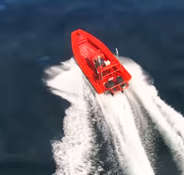
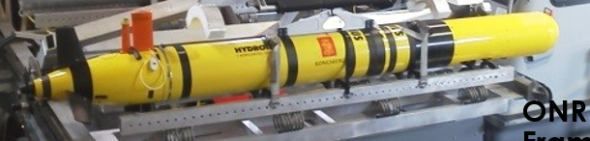
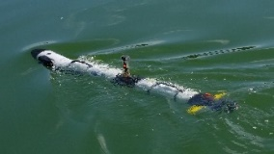
UMAA Products
Posted on Distro D website for industry access*
UMAA
Product Hierarchy
Published for government and industry partners as the basis for testing and verification
Published Feb 2019, released as Distro A in March 2020
Governing Documents
Architecture
Design
Description
Governance
Compliance
Specification
Formalized as NAVSEA Technical Publication T0300-BE-IDS-010
Models
Models
Used internally by UMAA team, available to programs as needed
Data
Models
Service
Specifications
DevOps
Pipeline
Tools
Posted as available
Interface Definition
Reference
Implementations
Formal releases published at regular intervals, developmental releases published continuously (DevOps pipeline)
Interface Control
Document (ICD) / Interface Definition Language (IDL)
…
Reference
Implementations
Interface Control
Document (ICD) / Interface Definition Language (IDL)
Reference
Implementations
* Originally hosted on Defense Intelligence Information Enterprise (DI2E), now transitioning to Naval LIFT

Slide 11
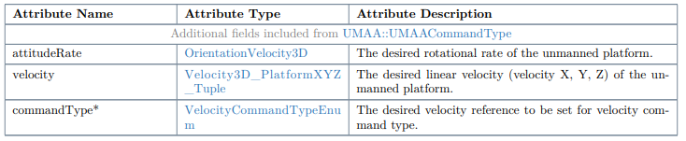
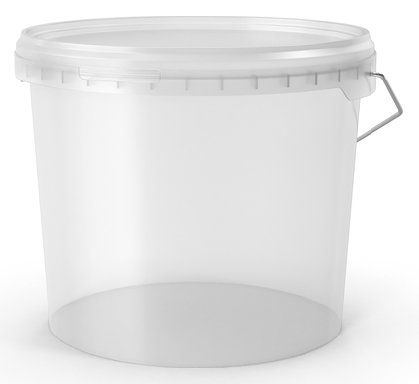
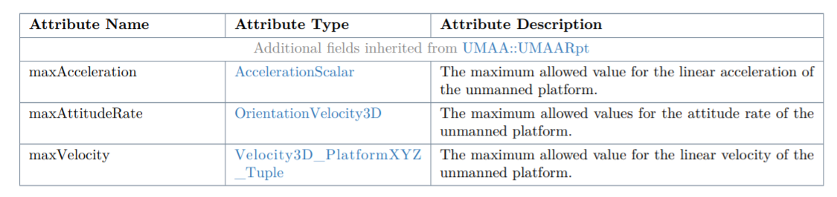
UMAA Interface Control Documents
Interface Control Documents (ICDs) – contain the definition for services that are building blocks for autonomy
ICDs will be extended over time – interfaces used in contractor-built services may be adopted into UMAA
This is a service interface example comprised of multiple attributes
VelocityControlCommand
ICDs are “buckets” that contain groups of logically related service interface definitions
services
services
services
services
services
services
Mission Management
(MM)
Situational Awareness
(SA)
Sensor and Effector Management (SEM)
Maneuver Operations
(MO)
Engineering Operations
(EO)
Support
Operations
(SO)
Processing Operations
(PO)
Communications Operations
(CO)

Slide 12

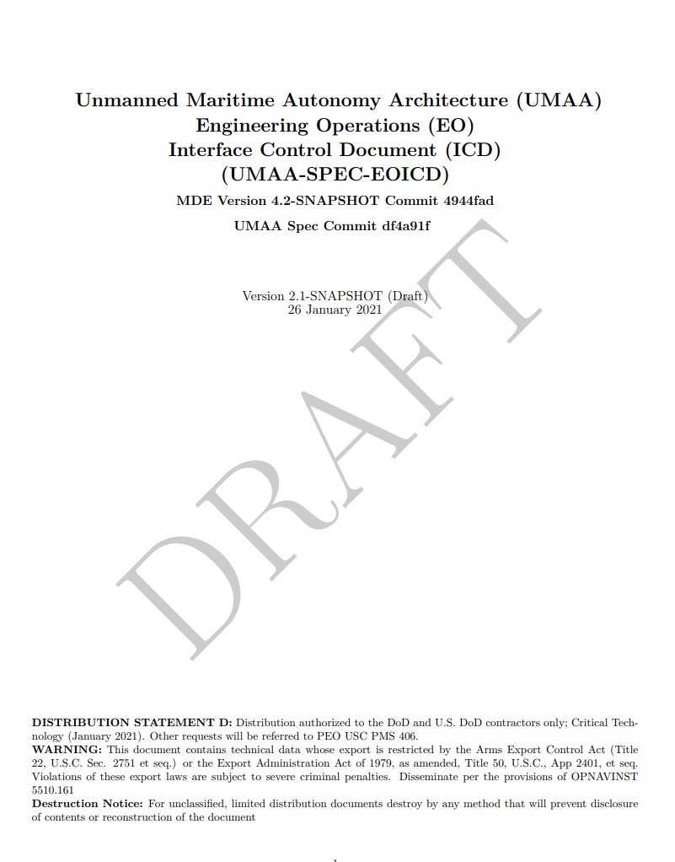
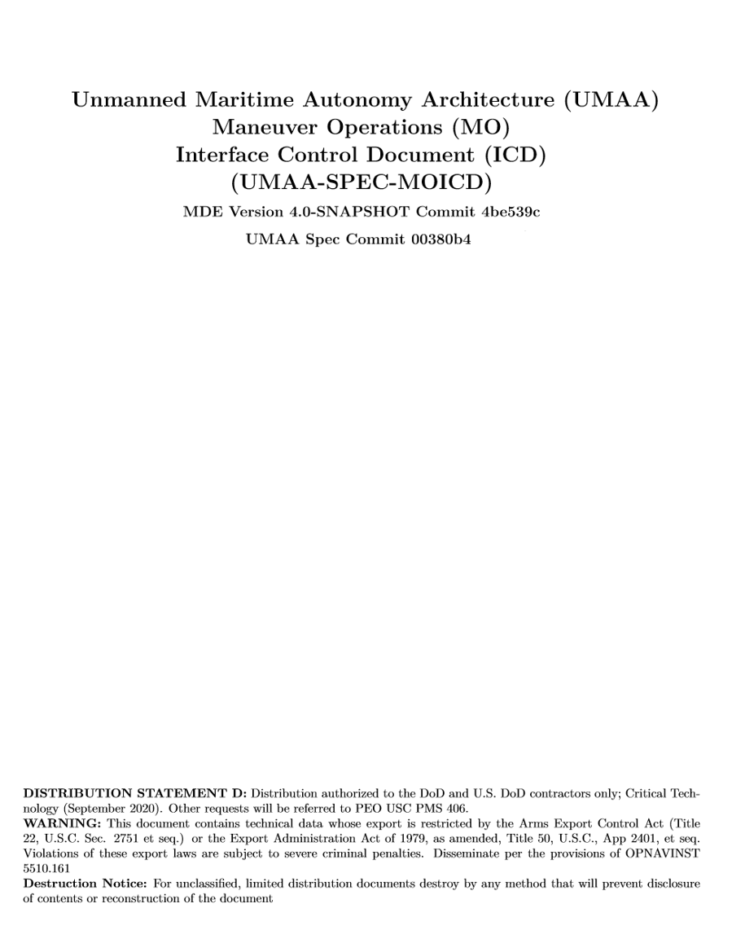
Release of ICDs and IDL
Prioritize,
Assess,
Approve
JIRA
Issues
*Specification Working Group (SWG), Reference Implementation Working Group (RWG)
JIRA
Issues
JIRA
Issues
Goal is to compress this cycle
UMAA
Board
JIRA
Issues
DISTRO A
Release Cycle
PMS 406
PM Review
Document
feedback
JIRA
Issues
JIRA
Issues
UMAA RWG*
Document
feedback
NAVSEA Public Release Review
PMS 406
Technical
Review
Four
Month
Cycle
?
JIRA
Issues
JIRA
Issues
JIRA
Issues
Optionally prototype
JIRA
Issues
JIRA
Issues
JIRA
Issues
Industry SME’s
Reference Implementation Teams
Program requests
UMAA SWG*
Final
Signoff
Document
feedback
Result
Implement ICD/IDL
Result
Specified on Contracts
Useable for industry products
Recommend for
R&D and Prototyping
(updates rarely back out…)
Four-month cycle
Ongoing…
Distro A will lag Distro D
ICDs/IDL
ICDs/IDL
Specified on Contracts
ICDs/IDL
Disto A
Developmental ICDs
Release ICDs
Four-month cycle – Distro D
(Feb 2021, June 2021, Oct 2021)
Release ICDs
Distro D to Distro A
(Review Dependent Dates)
Daily updates - Distro D

Slide 13
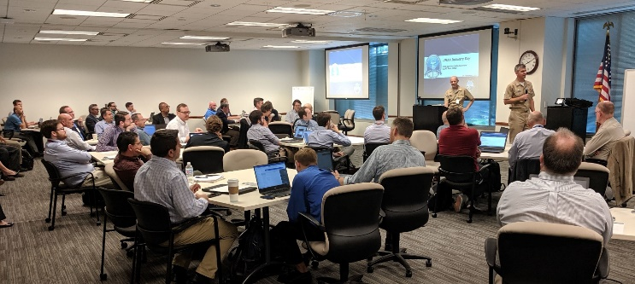
Industry Participation
Regularly scheduled industry forums (physical and virtual) – (275)
Open participation model
  Direct industry involvement through standard industry tools
  Atlassian tool set on Naval LIFT (Confluence, JIRA, Bitbucket)
  Industry can submit updated requests
  Industry can monitor evolution of UMAA standards via JIRA used by the UMAA board to specify updates and changes
  Continuous posting of updated developmental products
Reference Implementation Working Group (RWG)
  Ongoing example code responding to industry input to help boot-strap industry implementations, e.g., UMAA (How-To's) in Bitbucket
  Three RWG teams using UMAA ICD/IDL outputs

Slide 14
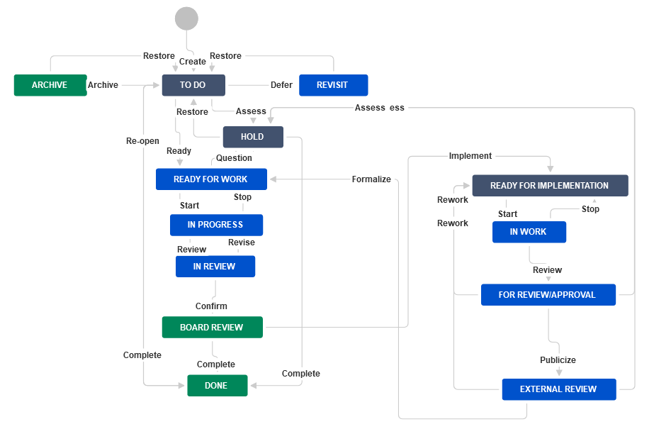
Process Workflow

Slide 15
UMAA Today
Released v5.2.1 April 20, 2022
Moving to a more controlled process
  High-bar for breaking changes, requiring PMS 406 approval
  Improved vetting and prototyping for new services
Transition from DI2E to Naval LIFT
Collaboration with PMS 406 Autonomy Framework Working Group (AFWG) to group services into components
Next Industry Day tentatively late Fall 2022

